Slide 1
Zeroing the Z Axis

Slide 2
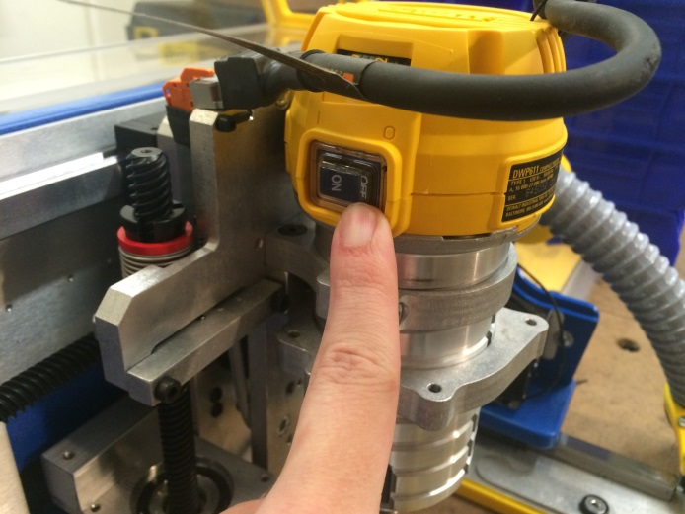
For safety, turn router power switch to “OFF”

Slide 3
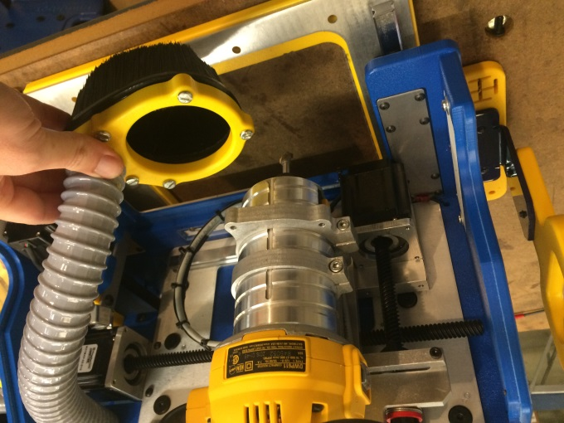
Remove vacuum foot by pulling it down from router bracket. Set vacuum foot out of the way, to the side.

Slide 4
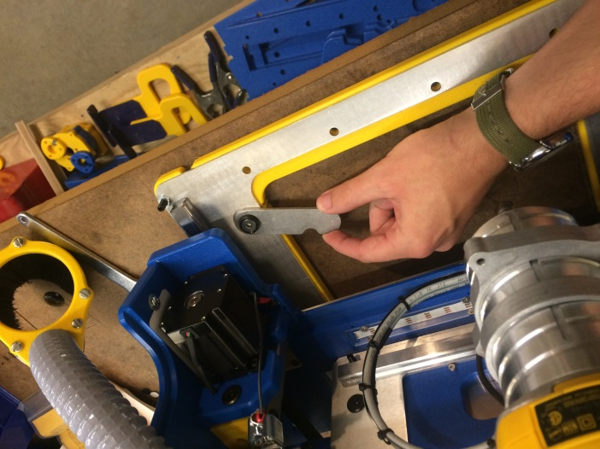
Flip Z-Zero plate out from right side of handibot base.

Slide 5
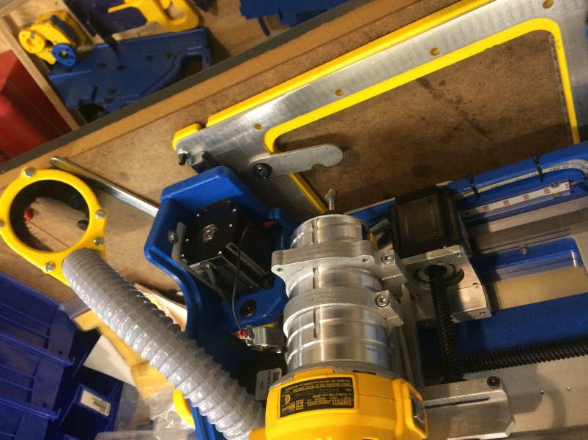
Move bit into place over Z-Zero plate.

Slide 6
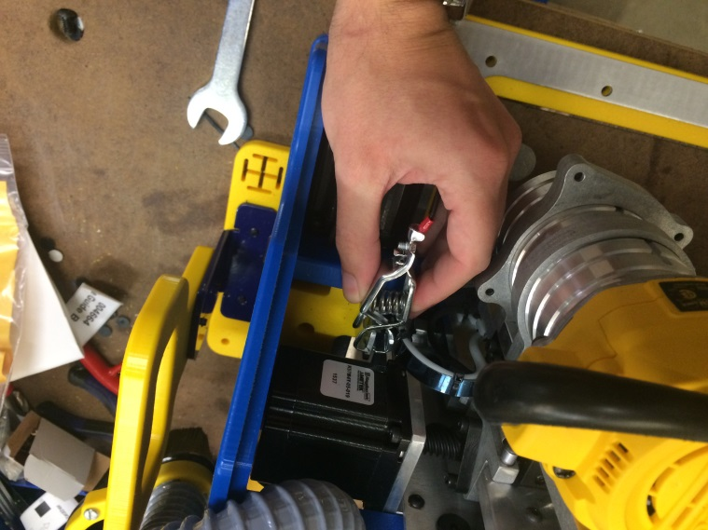
Remove bit clip from metal bracket on right side of tool.

Slide 7
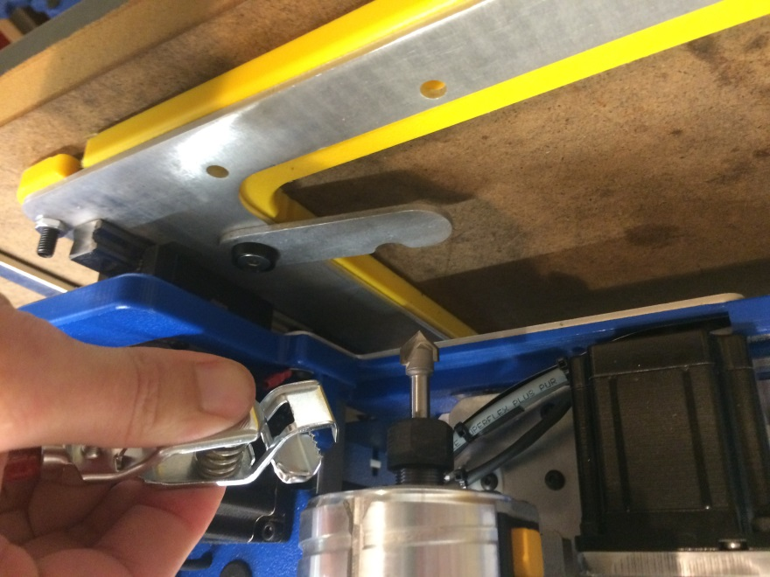
Attach clip to router collet.

Slide 8
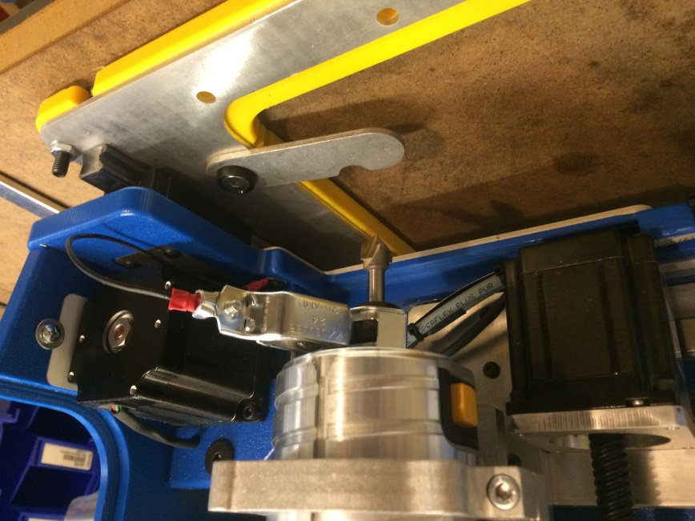
For safety, get your hands clear of the tool before starting the zeroing process!

Slide 9
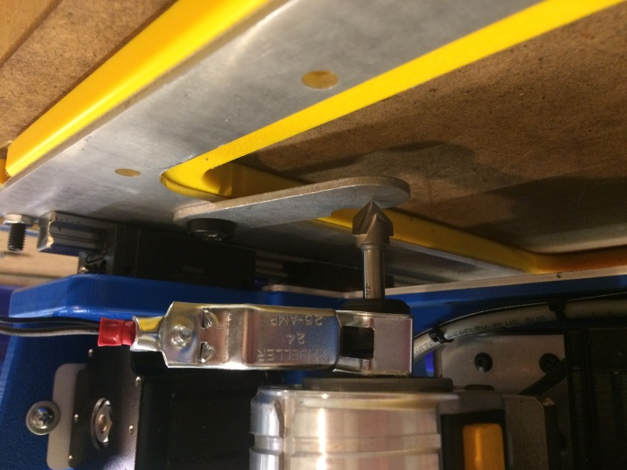
Tool will automatically touch off on Z-Zero plate and be offset based on the thickness of the handibot base.

Slide 10
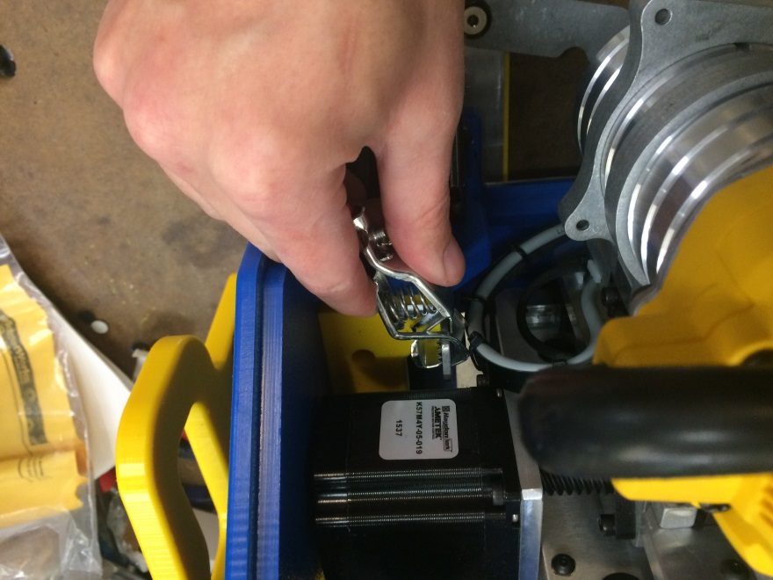
Be sure to put the clip back on the metal bracket on the right side of the tool.

Slide 11
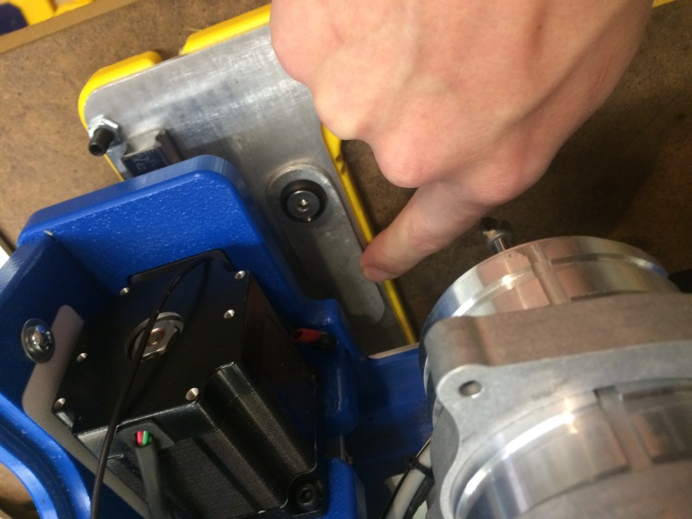
Flip Z Zero plate back into place on the tool base.

Slide 12
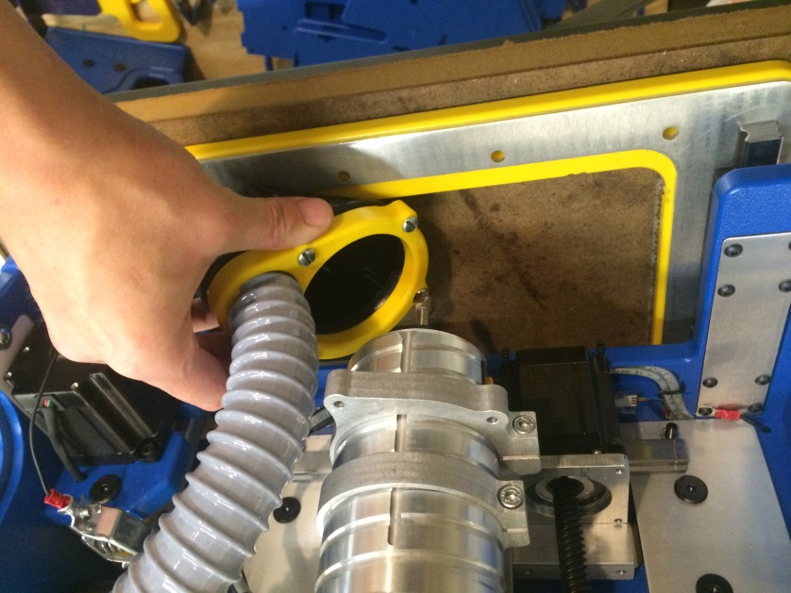
Clip vacuum foot back onto router bracket.

Slide 13
Turn router power switch back to “ON” to get ready to start cutting!

